Slide 1


Independent Work App
EARN EASILY

Slide 2

PROJECT REPORT
‘Independent Work App’
By
KOLIPATEL PRAGNESH
RATHOD KRUPESH
KUMBHANI KRUSHALI
Guided by
‘Prof. Nilam Shrimali’
C.U. SHAH INSTITUTE OF COMPUTER APPLICATION

Slide 3
Group no. 33
No. Name Enrollment No.
KOLIPATEL PRAGNESH 202012101538
RATHOD KRUPESH 202012101680
KUMBHANI KRUSHALI 202012101586

Slide 4
Project description:
In this Application Organizer can post event details as per requirement.
Following which, worker can apply for short term employment or for the event .
All the actions were handle by admin and small amount of commission will be taken on each successful reach of lead.

Slide 5
COMPANY DESCRIPTION:
Name of company will describe it self which is “INDEPENDENT WORK APP”, It’s easy to remember.
In this field of work, there are lots of mediator which sort of reduce the wage to the end user(worker).
There’s no proper connection, communication and trust bound between employer and end user, which makes this field look less attractive and dangers to the workers.
This types of problem lead us to the idea of this app which will eliminate the problem mentioned above (elaboration in ensuing slides).

Slide 6
COMPANY DESCRIPTION:
The problem will approached by Building direct platform and connection between Employer(Organizer) and Short term employee(Workers).
Not only this will solve the problem but also benefits both user in myriad ways likely reaching, connecting and scaling the whole field and many problems related to unemployment will be reduced.

Slide 7
Existing system
There is no exiting system currently in the industry, All the task are performed through WhatsApp groups.
Whenever someone in need of temporary work/worker they need contacts and WhatApp groups which is limited in size and capacity.
There are manifold groups available and do provide work but for the same work all the groups provide different ranges of payment which creates confusion and trust issues among workers.

Slide 8
Pros and cons of biased system (whatsapp)
Easy to find Work or Workers.
Better pay for Work.
Decrease commission and cuts.
No Different WhatsApp groups and fronts.
Direct interaction Between Organizer and Worker.
More Secure and encrypted system.
Risk of fraud
You don’t know exactly what work you are getting

Slide 9
Development tools and technologies
Tools
Android
Android Studio 2021.3.1
Technologies
Front-End
Mobile Application
Android(Android studio dolphin 2021.3.1)
Back-End
Mobile Applications
MySQL(Database)
SQLite(Database)
Other Tools
WPS Office (For Documentation, Presentation)
Darw.io (For Diagrams)

Slide 10
System Flow Diagram

Slide 11
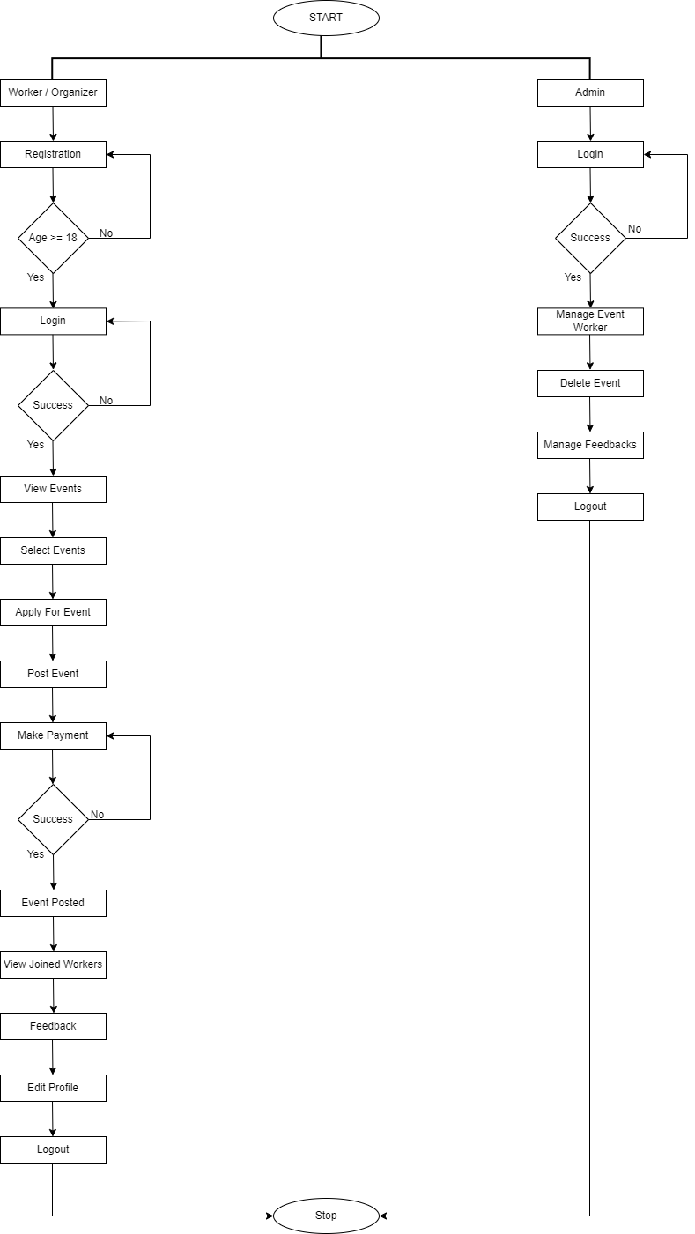

Slide 12
Use Case Diagram

Slide 13
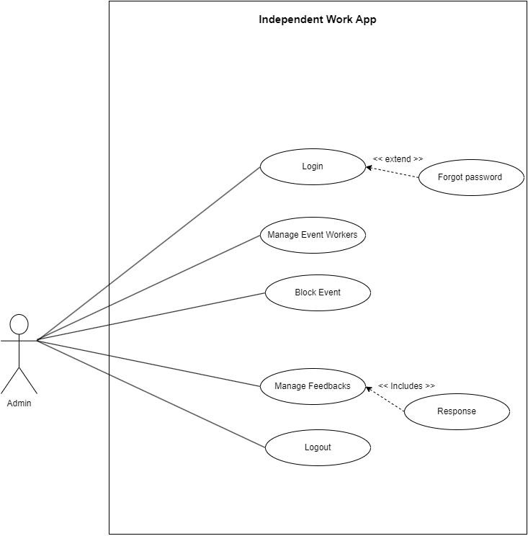
ADMIN SIDE

Slide 14
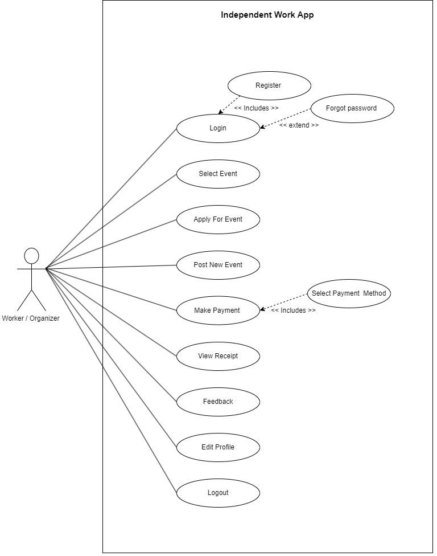
USER SIDE

Slide 15
Activity Diagram

Slide 16
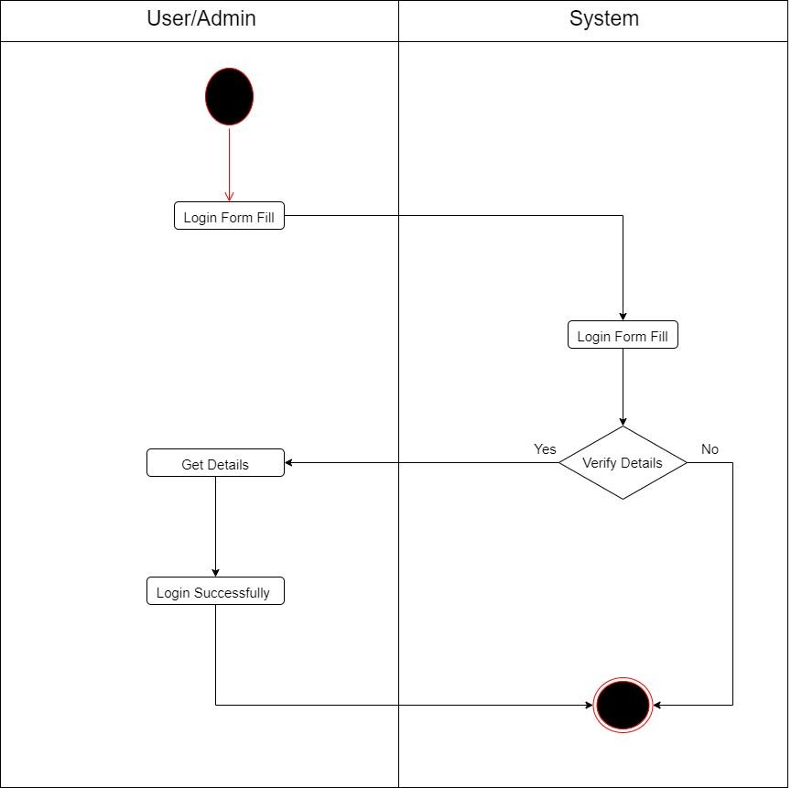
Login

Slide 17
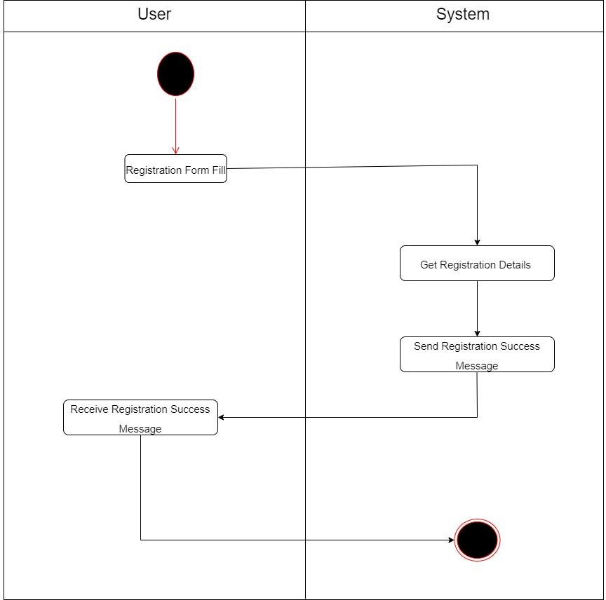
Registration

Slide 18
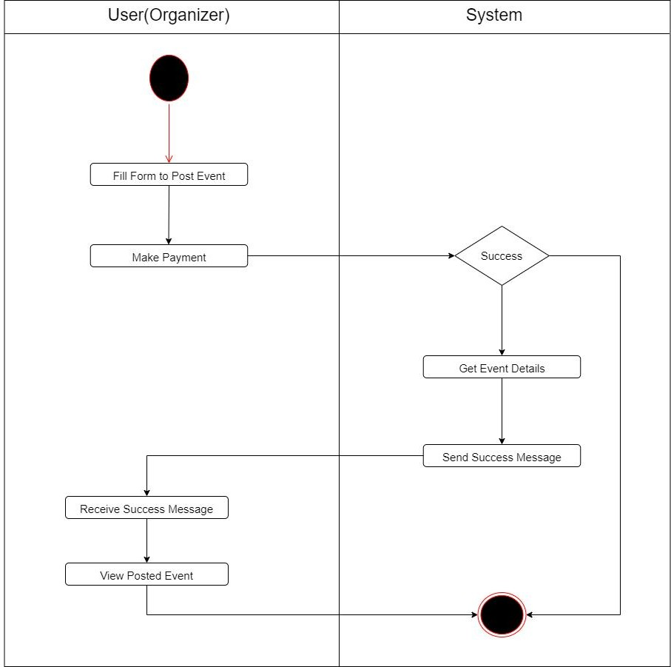
Post Event

Slide 19
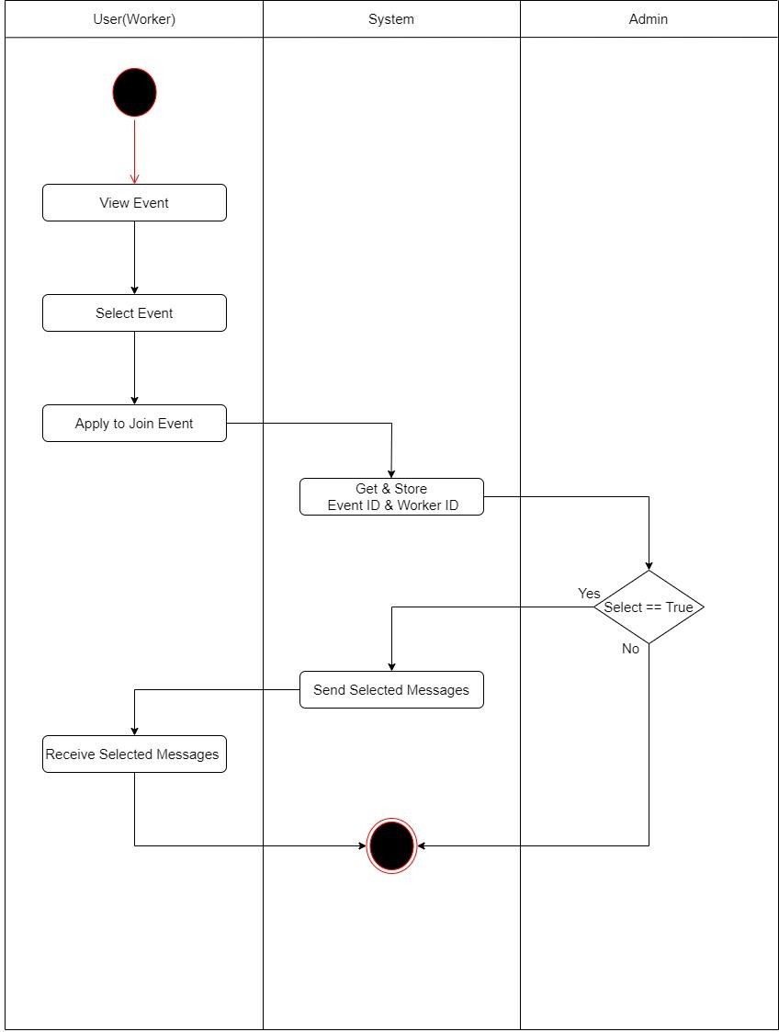
Apply Event

Slide 20
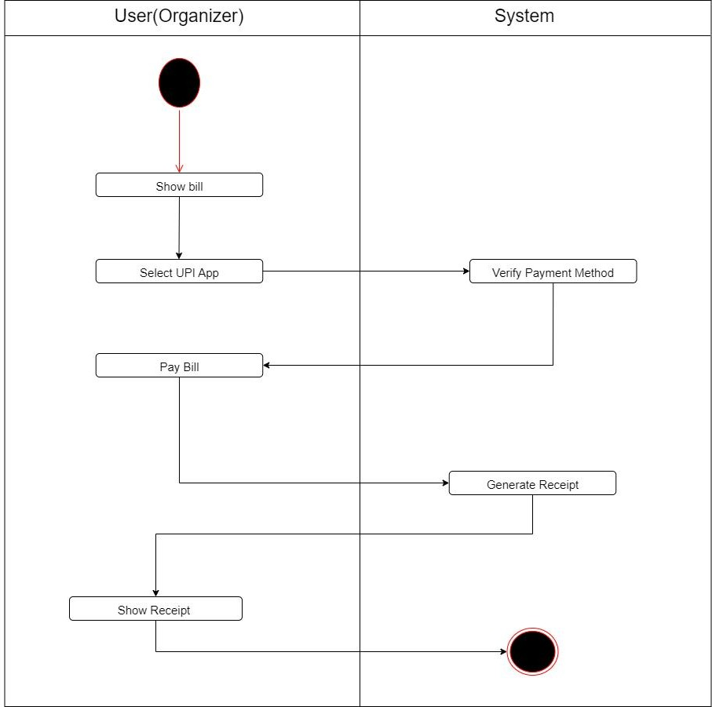
Payment

Slide 21
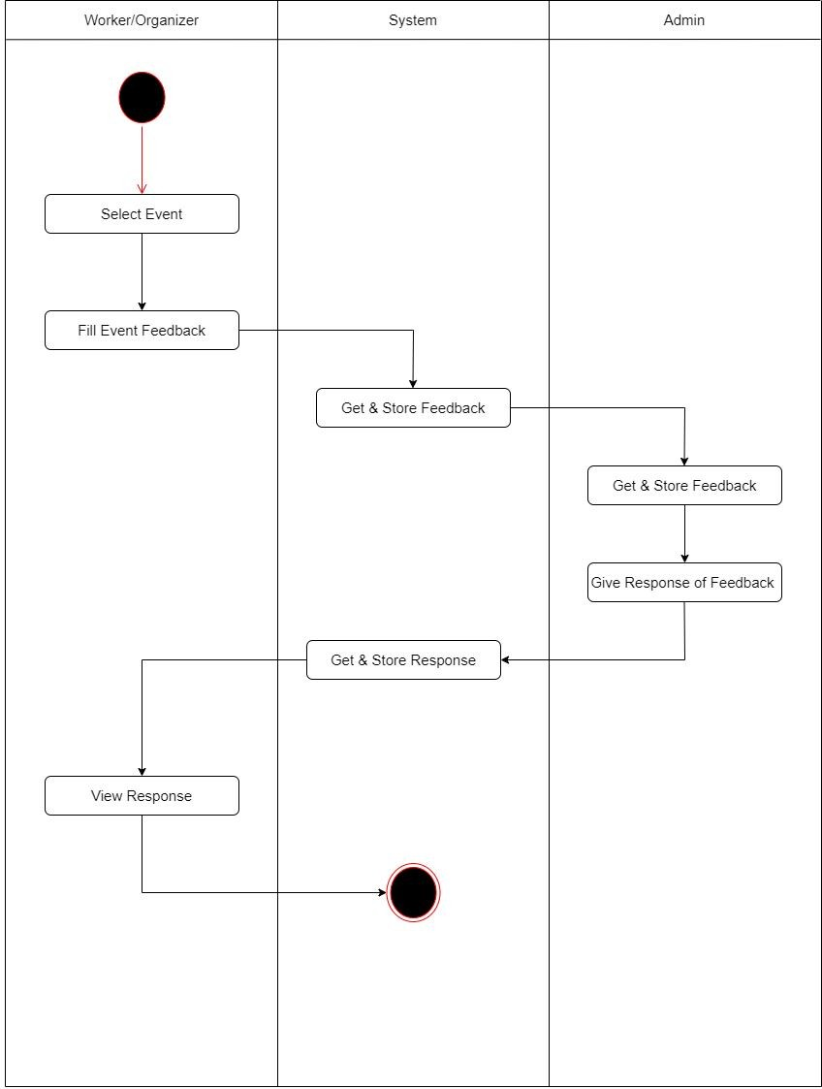
FeedBack

Slide 22
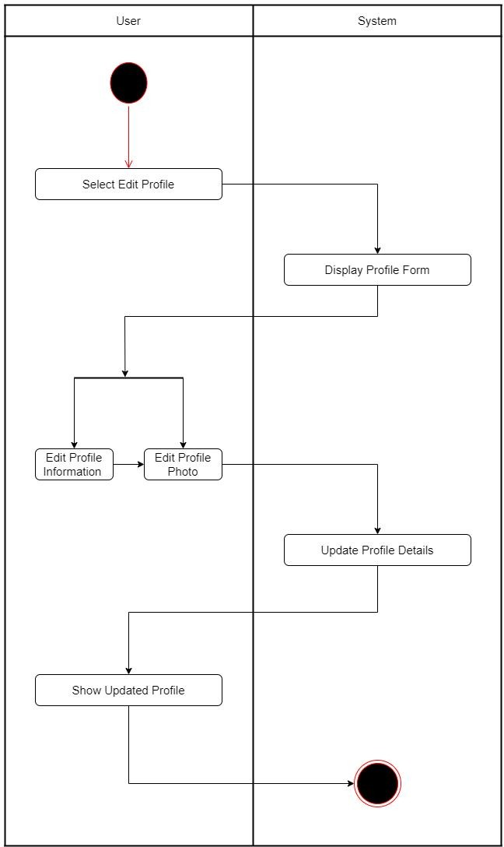
Edit Profile

Slide 23
Sequence Diagram

Slide 24
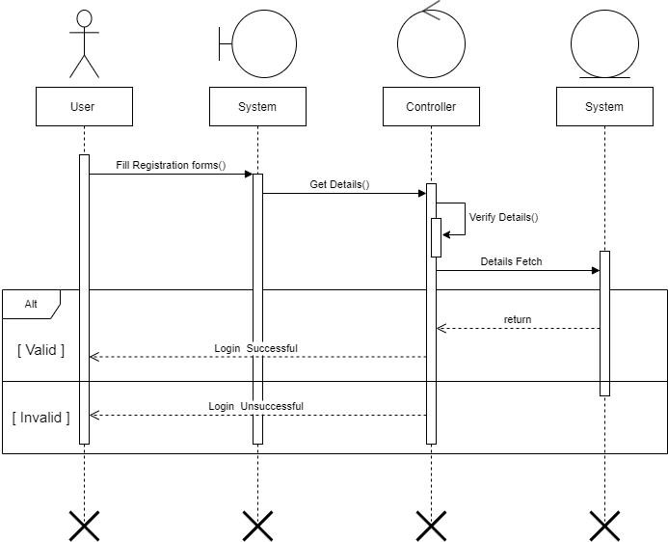
Login
Database

Slide 25
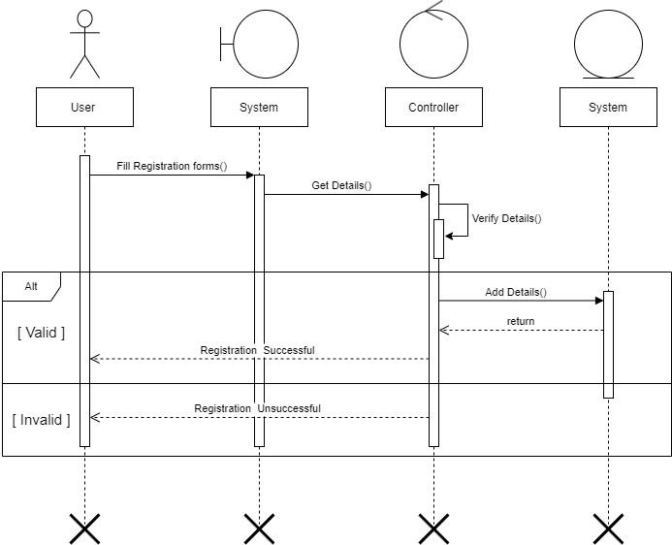
Registration
Database

Slide 26
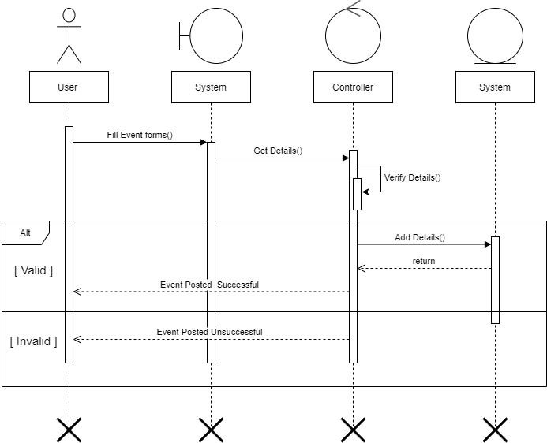
Post Event
Database

Slide 27
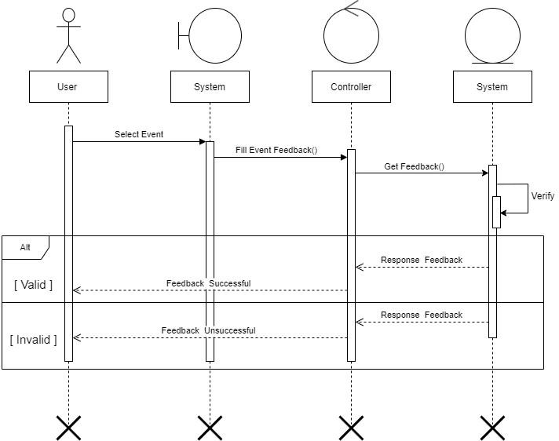
FeedBack
Database

Slide 28
Class Diagram

Slide 29
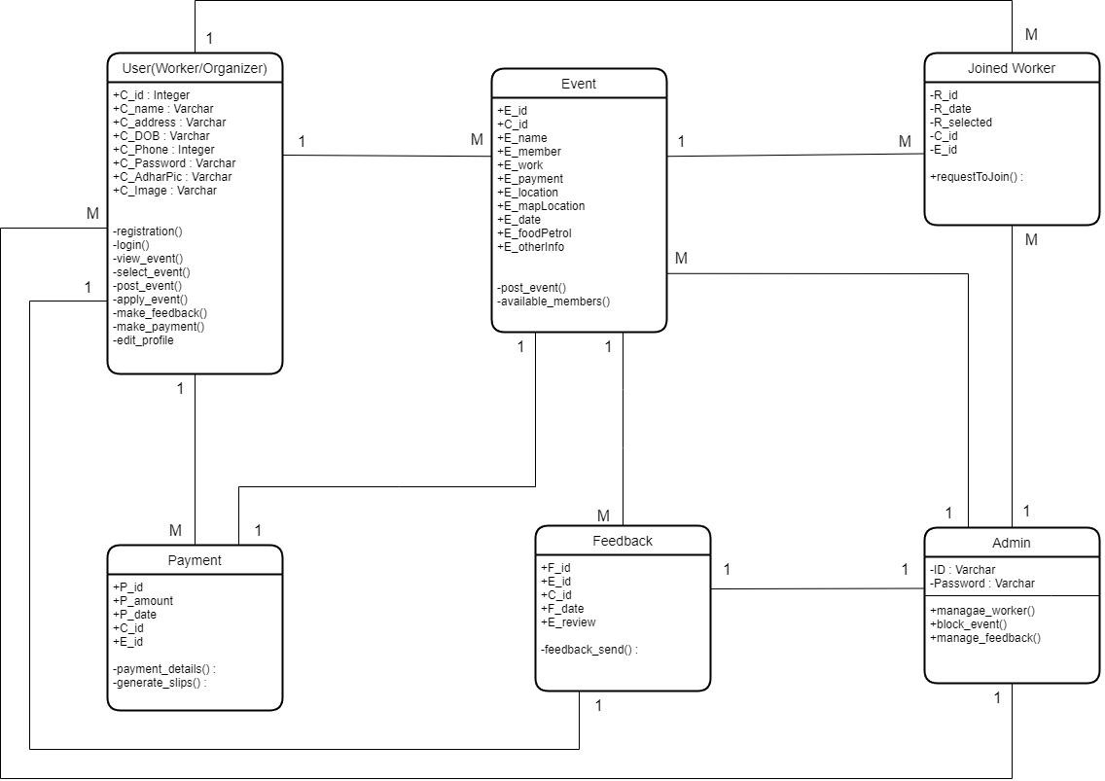

Slide 30
ER Diagram

Slide 31
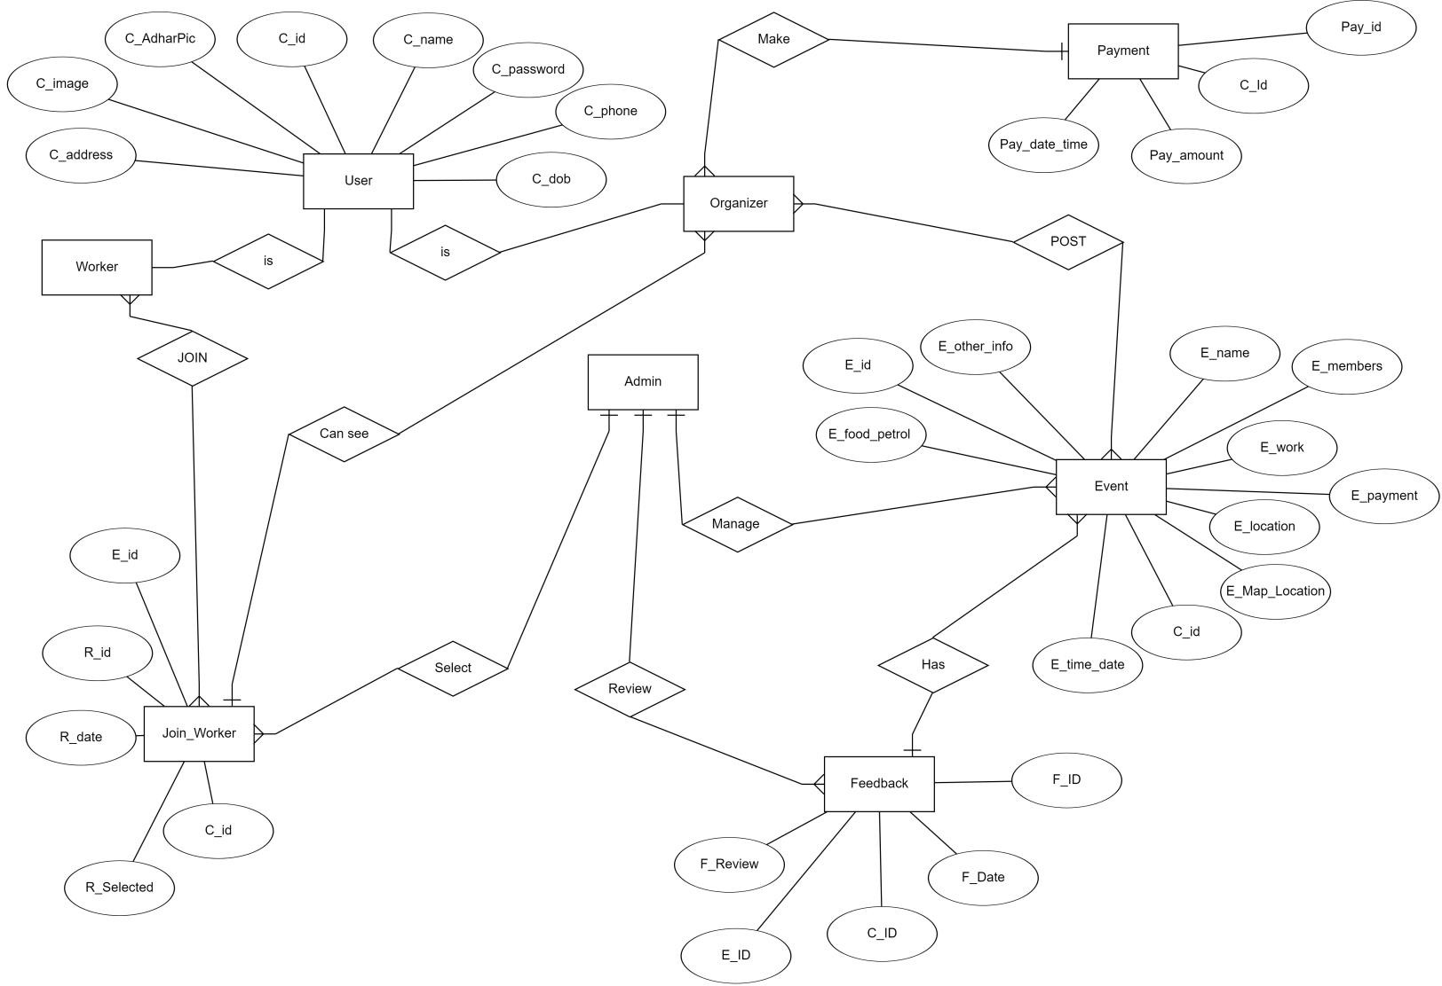

Slide 32
Data Dictionary

Slide 33
Admin : Store the information About Authentication
l This Table Shows the Details of the Admin.
Primary Key : --- TABLE : Admin Foreign Key : ---
Field Name | Datatype(Size) | Collection | Constraints | Description
ID | Varchar (15) | Utf8_unicode_ci | Unique / Not Null | Generated by Admin
Password | Varchar (30) | Utf8_unicode_ci | Not Null | Generated by Admin
This Table Shows the Details of the Admin (ID,Password).
ID is Unique and Password is Not Null in this Table.

Slide 34
User : Store the information About User
l This Table Shows the Details of the User.
Primary Key : C_Id TABLE : User Foreign Key : ---
Field Name | Datatype(Size) | Collection | Constraints | Description
C_Id | Integer (6) | - | Primary Key / Auto Inc. | Auto Generated by the Database
C_Name | Varchar (50) | Utf8_unicode_ci | Not Null | Generated by the End User
C_Password | Varchar (30) | Utf8_unicode_ci | Not Null | Generated by the End User
C_Address | Varchar(200) | Utf8_unicode_ci | Not Null | Generated by the End User
C_Phone | Integer (10) | - | Not Null | Generated by the End User
C_DOB | Varchar (10) | Utf8_unicode_ci | Not Null | Generated by the End User
C_AdharCard | Varchar (15) | Utf8_unicode_ci | Not Null | Generated by the End User
C_Image | Varchar (15) | Utf8_unicode_ci | Not Null | Generated by the End User
l This Table Shows the Details of the Customer (C_Id, C_Name, C_Password, C_Address, C_Phone, C_DOB, C_AdharCard, C_Image). l C_Id is Primary key In this Table. l Value of Primary Key is Auto Increment.

Slide 35
Event : Store the information About Posted Event
l This Table Shows the Details of the Posted Event.
Primary Key : E_Id TABLE : Event Foreign Key : C_Id
Field Name | Datatype(Size) | Collection | Constraints | Description
E_Id | Integer (6) | - | Primary Key / Auto Inc. | Auto Generated by the Database
C_Id | Integer (6) | - | Foreign key | Fetch Data From the user table
E_Name | Varchar (20) | Utf8_unicode_ci | Not Null | Generated by the End User
E_Members | Varchar (5) | Utf8_unicode_ci | Not Null | Generated by the End User
E_Work | Varchar (200) | Utf8_unicode_ci | Not Null | Generated by the End User
E_Payment | Integer (5) | - | Not Null | Generated by the End User
E_Location | Varchar (100) | Utf8_unicode_ci | Not Null | Generated by the End User
E_MapLocation | Varchar (100) | Utf8_unicode_ci | Not Null | Generated by the End User
E_Date | Varchar (10) | Utf8_unicode_ci | Not Null | Generated by the End User
E_FoodPetrol | Varchar (50) | Utf8_unicode_ci | Not Null | Generated by the End User
E_OtherInfo | Varchar (200) | Utf8_unicode_ci | Not Null | Generated by the End User
l This Table Shows the Details of the Customer (E_Id, C_Id,E_Name, E_Member, E_work, E_Payment, E_Location, E_MapLocation, E_Date, E_FoodPetrol, E_OtherInfo). l E_Id is Primary key and C_Id is Foreign Key in this Table. l Value of Primary Key is Auto Increment. Foreign Key Fetch the Data From User Table.

Slide 36
Joined_Worker : Store the information About Joined Worker
l This Table Shows the Details of the Workers Who Apply to Join the Event.
Primary Key : E_Id TABLE : Joined_Worker Foreign Key : C_Id,E_Id
Field Name | Datatype(Size) | Collection | Constraints | Description
R_Id | Integer (6) | - | Primary Key / Auto Inc. | Auto Generated by the Database
C_Id | Integer (6) | - | Foreign key | Fetch Data From the user table
E_Id | Integer (6) | - | Foreign key | Fetch Data From the Event table
R_Date | Varchar (10) | Utf8_unicode_ci | Not Null | Date is Auto Genereted When User Put Item in the Cart.
R_Selected | tinint (1) | - | Not Null | Generated by the End User
l This Table Shows the Details of the Customer (R_Id, C_Id,E_Id, R_Date, R_Selected).
l R_Id is Primary key and C_Id & E_Id is Foreign Key in this Table.
l Value of Primary Key is Auto Increment.
l Foreign Key Fetch the Data From User Table and Event Table.

Slide 37
Feedback : Store the information About Feedback
l This Table Shows the All the Feedback From the User and New Suggestion From Admin.
Primary Key : E_Id TABLE : Feedback Foreign Key : C_Id,E_Id
Field Name | Datatype(Size) | Collection | Constraints | Description
F_Id | Integer (6) | - | Primary Key / Auto Inc. | Auto Generated by the Database
C_Id | Integer (6) | - | Foreign key | Fetch Data From the user table
E_Id | Integer (6) | - | Foreign key | Fetch Data From the Event table
F_Date | Date | - | Not Null | Date is Auto Genereted When User Put Item in the Cart.
F_Review | Varchar (200) | Utf8_unicode_ci | Not Null | Generated by the End User
l This Table Shows the Details of the Customer (F_Id, C_Id,E_Id, F_Date, R_Review).
l F_Id is Primary key and C_Id & E_Id is Foreign Key in this Table.
l Value of Primary Key is Auto Increment. Foreign Key Fetch the Data From User Table and Event Table.

Slide 38
Payment : Store the information About Payments.
l This Table Shows the All the Payments.
Primary Key : P_Id TABLE : Payments Foreign Key : C_Id,E_Id
Field Name | Datatype(Size) | Collection | Constraints | Description
P_Id | Integer (6) | - | Primary Key / Auto Inc. | Auto Generated by the Database
C_Id | Integer (6) | - | Foreign key | Fetch Data From the user table
E_Id | Integer (6) | - | Foreign key | Fetch Data From the Event table
P_Date | Date | - | Not Null | Date is Auto Genereted When User Put Item in the Cart.
P_Amount | Integer (10) | - | Not Null | Generated by the End User
l This Table Shows the Details of the Customer (P_Id, C_Id,E_Id, P_Date, P_Amount).
l P_Id is Primary key and C_Id & E_Id is Foreign Key in this Table.
l Value of Primary Key is Auto Increment. Foreign Key Fetch the Data From User Table and Event Table.

Slide 39
References Link:
www.draw.io
www.tutorialspoint.com
www.w3schools.com
www.visio.com
www.stackoverflow.com

